Slide 1











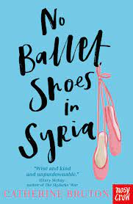



Christ the King Primary School
SUMMER Term in Year 6
Maths
English
  Geometry: Properties of Shapes
  Number: number and place value
  Statistics : Graphs and Tables
We are reading
No Ballet Shoes in Syria: diary entry, letter, setting description
Alma: narrative story
Robin Hood: explanation text- how to survive in the forest, playscript
SATS: should they be abolished?
Free verse poetry
Balanced argument, narrative, recounts, narrative poetry and journalistic writing.
We will be focusing on making justified inferences.
Reading takes place daily and whole class reading will also take place.
It is extremely important that all children know their times tables by heart and inverse division facts.
Science
Light
Identify sources of light & revise facts that light travels in straight lines & opaque objects form shadows.
Understand that to see, light needs to enter the eye. Investigate light reflection & refraction, white light made of many colours & the speed of light.
Science
Electricity
1a Construct circuits, incorporating a battery & range of switches to make devices work.
1b Find out the effect of changing components in circuits, making bulbs brighter or dimmer.
Breadth of study: 1d Carry out a range of scientific investigations.
2b Recognise there are hazards in physical processes, and assess risks and take action to reduce risks to themselves and others.

Slide 2
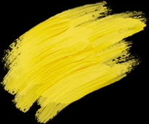









History
Religious Education
Our topic for history is The Changing Role of Women.
The children will be investigating how the role of women has changed in history from ancient civilisation to modern times.
Enquiry questions:
What role did women play in WW1?
Who were the suffragettes and why did they campaign for change?
Discuss and evaluate the issue of gender equality today.
P.E
Football, cricket, athletics and rounders
Music
Charanga and end of year play
Computing
Spreadsheets and PowerPoint
French
The weekend and me in the world
In RE this term the focus will be:
Easter
Belonging to the Church community
Pentecost
Baptism and Confirmation
As our children prepare for making the sacrament of Confirmation, they will have opportunities to share their chosen saint.
It is also important that the children try and attend 9am Sunday Mass to sing in the choir.
Art
The Seaside
Drawing details in pen
Printing
Weaving with plastic
Make a lantern
Design Technology
Felt phone cases
Write a design criteria
Communicate design ideas
Make a paper template
Use different types of stitches
Select decorative techniques and fastenings
Evaluate my design
Geography
Trade and economics
What do we trade?
Who do we trade with?
Explain the links between El Salvador and the UK
Explain the importance of Fair Trade
Explain the Global Supply Chain
.

