Slide 1














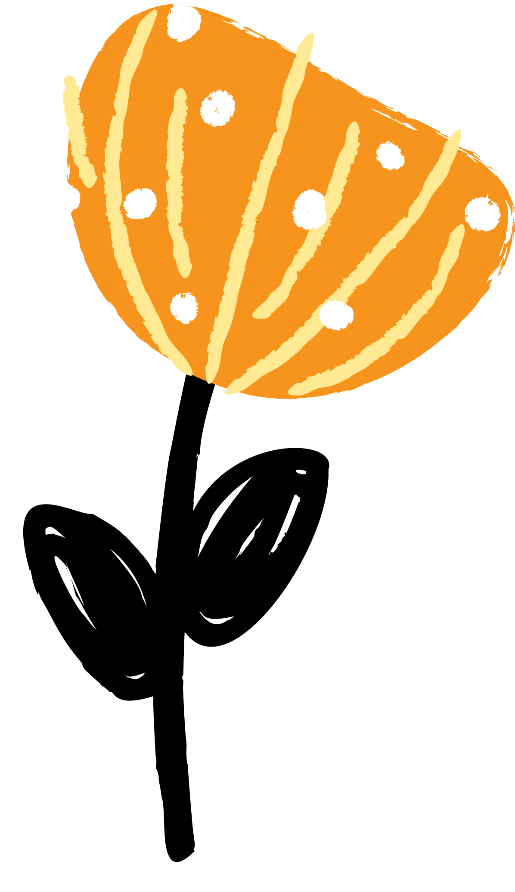


Christ the King Spelling list
Spelling list: stage six
Name:_____________________
Tested on:
07.03.23
Tested on:
14.03.23
Tested on:
21.03.23
Tested on:
28.03.23
contest
freeze
impact
increase
object
permit
produce
silence
Subject
transport
blown
known
mould
poultry
shallow
shoulder
smoulder
soul
thrown
window
celebrate
cemetery
certificate
deceased
December
hindrance
necessary
nuisance
prejudice
sacrifice
disappointed
dissatisfied
dissimilar
impatient
overreact
overrule
overseas
unnatural
unnecessary
unsure
Tested on:
18.04.23
Tested on:
25.04.23
Tested on:
02.05.23
Tested on:
alphabet
elephant
dolphin
graph
pamphlet
pheasant
phone
photo
physical
sphere
ballet
blizzard
bungalow
easel
gymkhana
hoist
origin
pyjamas
restaurant
veranda
definitely
desperate
environment
explanatory
jewellery
poisonous
reference
secretary
temperature

