Slide 1







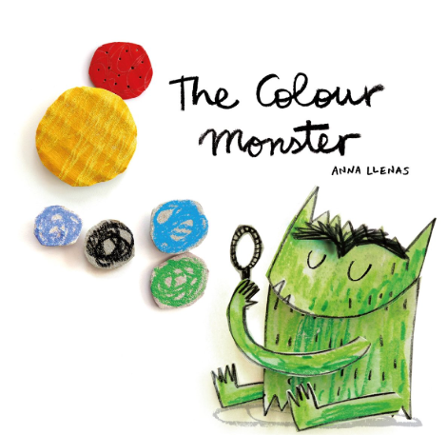


Christ the King Primary School
Autumn One in Year 1
Maths
English
We are reading
We will be looking at:
  Number formation
  Number recognition
  Number bonds
  Counting accurately
  Operations involving +/-
  Properties of 2D and 3D shape
  .
We are looking at re-telling stories, description and lost posters.
We will be focusing on:
Phonics
Traditional Tales – The Enormous Turnip
Classic Stories
Character descriptions
Speaking and listening
Reading comprehension
Please access Doodle Maths at home!
We will be developing our fluency, pace and stamina.
We hear the children read as regularly as we can in Year 1. Your child will benefit greatly from reading with you each night at home..
Science
We will be looking at Animals including Humans and Seasonal Changes.
We will be investigating:
  Animal classification
  Diets
  The Human Body including senses
  We will also be observing the changes from Summer to Autumn.

Slide 2




Religious Education
History
This term, the children will be learning about Creation and Covenant, exploring how the universe and everything in it is a beautiful gift from God. Through this topic, they will discover the wonder of the Genesis creation story and learn that every single person is uniquely made and loved by God.
The children will also explore their role as stewards of the earth, discovering practical ways they can care for nature and protect our "Common Home."
ART – Nature Sculptures.
We will be exploring the life of Grace O’Malley during our History Deep Dive this term.
Children will explore different elements of nature and use them to inspire their own creations such as drawings and 3D models. The children will also learn about Andy Goldsworthy and create their own land art.
Geography
In Geography, the children
will be focusing on the topic of What is it like here? The children will be exploring the local area and identifying the key features of our environment.
P.E
Children will learn fundamental skills through the use of the scheme, Get Set 4 PE.
Music
Children will be following the Charanga scheme of work along with weekly hymn practices.
Computing
We will be learning about Technology around us.

